Slide 1

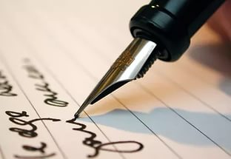
Informal letter

Slide 2
